Slide 1

20EC5203 ELECTRONIC DESIGN PROJECT- I MODULE 1 – LETTER CARD COUNTER USING LDR MODULE 2 – ACCIDENT PREVENTION IN HILL STATION USING IR SENSOR
Presented by:
SARUMATHI S - 811722106095
SHARMILA K - 811722106100
MAMATHIKA M - 811722106049
Under the Guidance of
Mrs.K.KARPOORA SUNDARI
ASSISTANT PROFESSOR
DEPARTMENT OF ECE

Slide 2
OUTLINE
ABSTRACT
INTRODUCTION
BLOCK DIAGRAM
CIRCUIT DIAGRAM
HARDWARE MODULE
ADVANTAGES AND APPLICATIONS
CONCLUSION
REFERENCES

Slide 3
MODULE 1 – LETTER CARD COUNTER USING LDR

Slide 4
ABSTRACT
This project focuses on designing a letter counter system using a Light Dependent Resistor (LDR) and associated circuitry. The system detects letters or objects passing through a light path, converts the changes in light intensity into electrical signals, and counts these signals using a 4033 decade counter IC. The count is visually displayed on a seven-segment display. The setup includes essential components such as a signal conditioning circuit, which ensures reliable signal processing, and a reset button for resetting the count. A 9V power supply drives the entire circuit. This project is a practical and cost-effective solution for applications such as document sorting, assembly lines, or educational tools demonstrating electronics concepts.

Slide 5
INTRODUCTION
The letter counter project is an innovative application of basic electronic components to create a system that detects and counts objects or letters as they pass through a predefined path. The primary sensing element in this project is a Light Dependent Resistor (LDR), which changes its resistance based on the intensity of incident light. By strategically placing the LDR in a light path, any object or letter interrupting the light causes a measurable signal change. This signal is then processed and counted using a signal conditioning circuit and a 4033 decade counter IC.The output count is displayed on a seven-segment display, providing a clear and user-friendly visual representation. A reset button is incorporated to allow manual resetting of the count to zero, enhancing the usability of the system. The project is powered by a simple 9V battery, making it portable and easy to use.

Slide 6
Objectives:
• To notify user about urgent letters.
• To preserve the condition of the letters.
• To modify the existing letter box.
Scope of this project:
• Making a real time monitoring and remote connected system using GSM.
• The counter can be integrated into smart home systems, enabling users to receive notifications on their smartphones when a letter is detected.

Slide 7
LITERATURE SURVEY
REF NO | TITLE & AUTHOR | COMPONENTS USED | PROS | CONS
1 | Design and Construction of an Electronic Letter Box with Counters and Wireless Feedback | LDR, LED, GSM module, resistors. | Detects mail without opening the box, remote notification via GSM. | False triggers with opaque materials and dependency on a continuous power supply
2 | Design and Construction of an Electronic Letter Box Using Seven-Segment Display | LDR, LED, seven-segment display, resistors, counter IC. | Simple visual indication of letter count. | Simple visual indication of letter count.
3 | Letterbox with Letter-Counting Facility | LDR, LED, NE555 timer, seven-segment driver, seven-segment display. | Detects mail without opening the box, remote notification via GSM. | False triggers with opaque materials and dependency on a continuous power supply
4 | Design of a Microcontroller-Based Letterbox Counter | Microcontroller, LCD display, sensors, switches. | Accurate counting with microcontroller integration and better interface options. | More complex and costly due to microcontroller usage.
5 | An Efficient Electronic Letterbox with Wireless Feedback System | Proximity sensors, wireless module, resistors, LED indicators. | No need for physical checking of the mailbox, with wireless feedback | Higher energy consumption and possible signal interference.

Slide 8
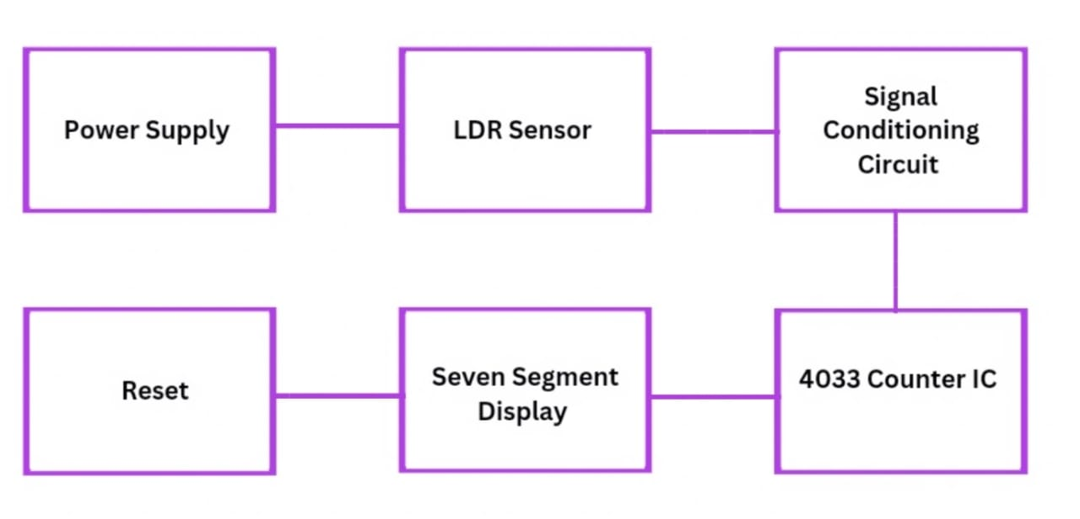
BLOCK DIAGRAM

Slide 9
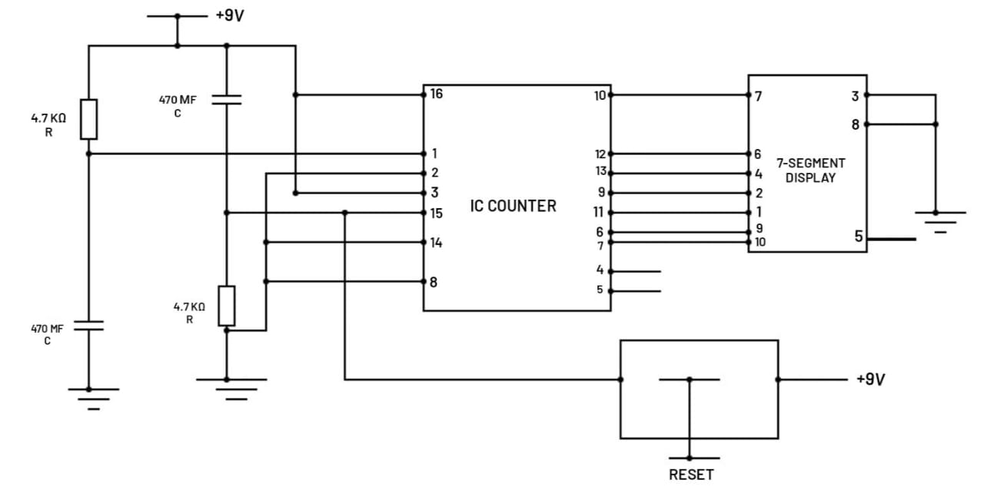
CIRCUIT DIAGRAM

Slide 10
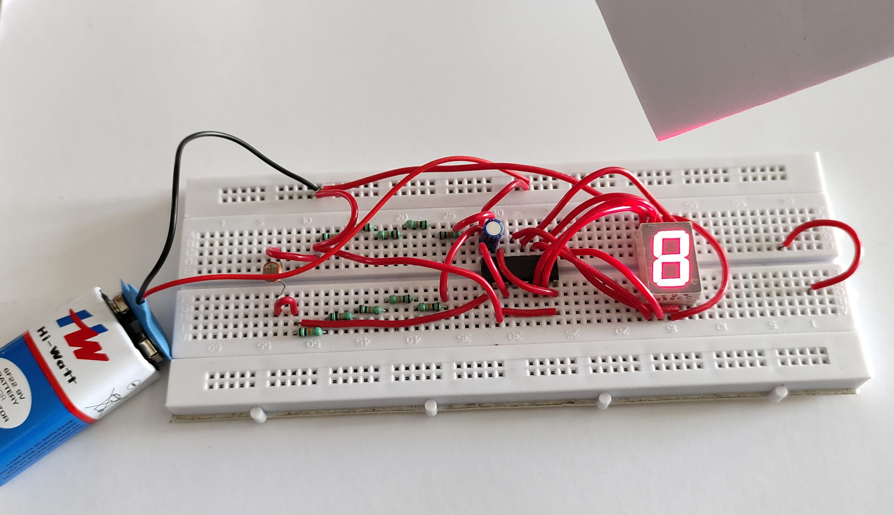
HARDWARE MODULE
https://drive.google.com/file/d/13vwz5XfjT2HtJ9olyWraI0y-lfMLno2l/view?usp=drivesdk

Slide 11
BreadBoard x 1
Connecting Wire
9Volt Battery x 1
HCF4033BE IC x 1
A Seven Segment Display x 1
10 Micro Farad Capacitor x 1
LDR x 1
50K Ohms Resistors x 2

Slide 12
ADVANTAGES AND APPLICATIONS
ADVANTAGES:
Cost-Effective
Simplicity and Reliability
Accurate and Efficient
Scalable and Flexible
APPLICATIONS:
Postal and Courier Services
Offices and Workplaces
Warehouses and Distribution Centers
Libraries and Document Management Systems

Slide 13
MODULE 2 – ACCIDENT PREVENTION IN HILL STATION USING IR SENSOR

Slide 14
ABSTRACT
The accident prevention in hill station that addresses the growing need for effective solutions to reduce road accidents, particularly in challenging terrains like hill stations. These areas often face unique problems such as narrow roads, sharp curves, steep slopes, poor visibility due to fog or rain, and risks of landslides. Conventional safety measures often fail to provide real-time alerts, leading to delayed driver reactions and accidents. Despite its effectiveness, the system has limitations, such as a restricted detection range and reduced accuracy in adverse weather conditions, which may affect performance. However, its cost-effectiveness and portability make it a promising solution for improving road safety and minimizing accidents in critical environments.

Slide 15
INTRODUCTION
Accident prevention is designed to enhance safety on roads , particularly in high risk areas such as hill stations. These regions face unique challenges, including sharp curves, steep slopes, and poor visibility due to fog and rain, which contribute to a high rate of accidents. This project aims to provide a cost-effective, portable, and efficient solution for detecting obstacles and alerting drivers in real time, thus reducing accidents and ensuring smoother traffic flow. The objective is to develop a system that leverages IR sensors, LEDs, and buzzers to improve driver awareness and response time. The scope of this project extends to challenging terrains, school zones, construction sites, and other accident-prone areas, offering adaptable and reliable safety solutions for diverse environments.

Slide 16
Objectives:
To develop a real-time obstacle detection and alert system. To minimize road accidents by improving driver response. To create a cost-effective and portable safety model.
Scope of this project:
Usable in hilly terrains and accident-prone areas. Applicable in school zones and construction sites. Adaptable for various road safety enhancements.

Slide 17
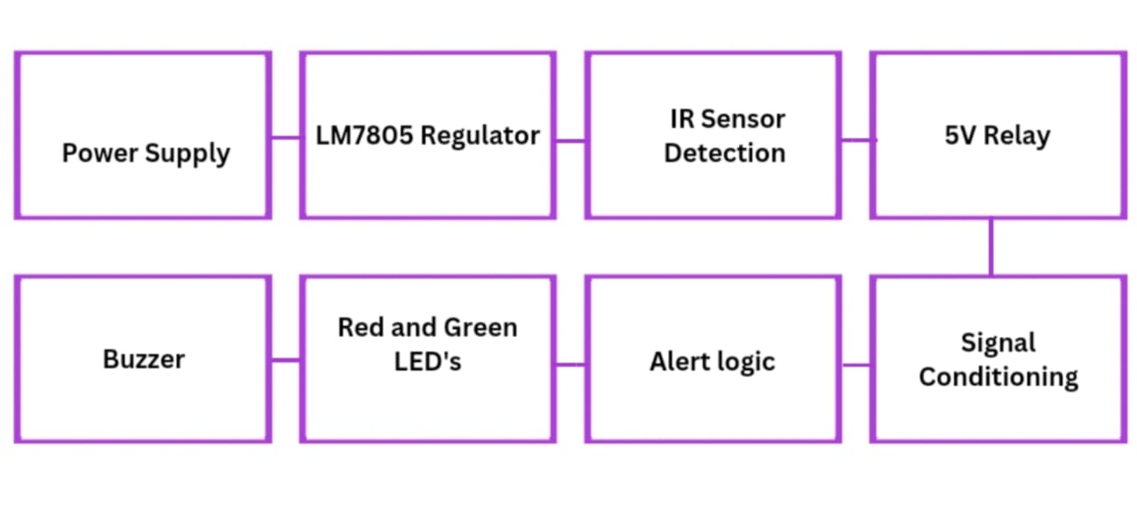
BLOCK DIAGRAM

Slide 18
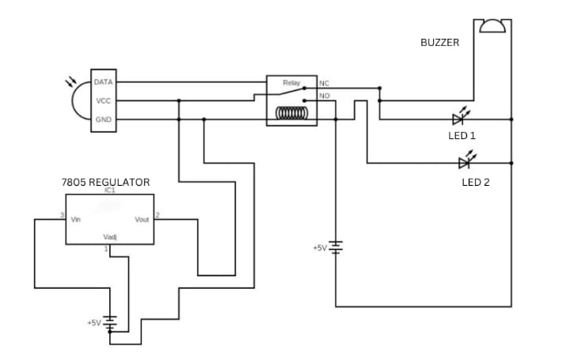
CIRCUIT DIAGRAM

Slide 19
LITERATURE SURVEY
REF NO | TITLE & AUTHOR | COMPONENTS USED | PROS | CONS
1 | Title: Obstacle Detection Using IR Sensors for Road Safety Authors: A. Kumar, P. Sharma | IR sensors, transistors, LEDs, resistors, buzzers | Low cost, simple implementation, real-time obstacle detection. | Limited range, ineffective in adverse weather conditions
2 | Title: Road Accident Prevention System for Hilly Areas. Authors: R. Singh, M. Gupta | IR sensors, voltage regulators, microcontroller, LEDs, buzzers. | Effective in detecting vehicles on sharp curves, improves driver awareness. | Requires regular maintenance, limited power efficiency.
3 | Title: IR Sensor-Based Accident Prevention System Authors: S. Patel, K. Das | IR modules, 2N2222A transistors, 9V batteries, buzzers, LEDs. | Portable, reliable in detecting nearby obstacles. | Inaccurate in detecting fast-moving objects, limited sensor sensitivity
4 | Title: Smart Road Safety Model Using Embedded Systems. Authors: T. Verma, L. Rao | IR sensors, microcontroller, batteries, LED indicators, buzzers | Advanced embedded design, customizable for different terrains | Higher cost compared to simpler models, requires technical expertise
5 | Title: Accident Prevention Using Infrared Technology Authors: N. Prasad, V. Shetty | IR sensors, voltage regulator (LM7805), switches, resistors, LEDs | Easy to set up, suitable for small-scale deployment | Limited detection range, affected by environmental factors like fog and rain

Slide 20
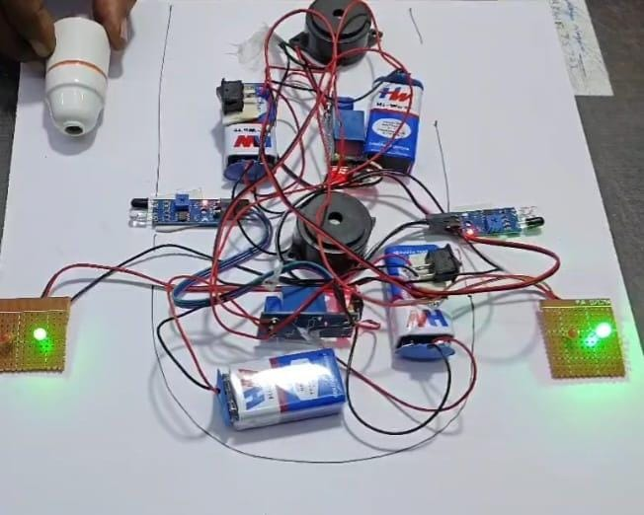
HARDWARE MODULE
https://drive.google.com/file/d/13fizNW9Vx6kEfXV_jxJuYJcJjs4h_JZ1/view?usp=drivesdk

Slide 21
Zero PCB x 2
1-Meter belt wire
9 Volt battery x 4
Battery cap x 2
IR module x 2
5v Relay x 2
Buzzer x 2
7805 regulator x 2
Red LED x 2
Green LED x 2

Slide 22
ADVANTAGES AND APPLICATIONS
ADVANTAGES:
Portable and easy to install. Provides quick response to potential hazards.
Energy-efficient design with minimal power consumption. Simple and user-friendly alert system.
APPLICATIONS:
Smart pedestrian crossing alerts. Traffic light automation and monitoring Parking assistance systems. Railway level crossing safety systems.

Slide 23
CONCLUSION
The letter counter project demonstrates a practical implementation of basic electronic components, including an LDR, signal conditioning circuit, 4033 counter IC, and seven-segment display, to create a simple yet effective counting system. It highlights key principles of automation and electronics while offering real-world applications in areas such as document tracking, production lines, and education.
Accident prevention in hill stations is a critical aspect of ensuring road safety and protecting lives in challenging terrains. Implementing technologies such as IR sensors, coupled with advanced monitoring systems, can significantly reduce the risks associated with steep slopes, sharp curves, and adverse weather conditions. These systems enable real-time detection of obstacles, alert drivers to potential hazards, and enhance visibility in low-light conditions.

Slide 24
REFERENCES
1.Sharma, P., & Gupta, R. “Design and Implementation of a Letter Counter System Using LDR,” Journal of Electronics and Communication Engineering, vol. 11, no. 4, pp. 210-215, 2020.
2. Patel, R., & Desai, V. “LDR-based Optical Counter for Character Recognition and Counting,” International Journal of Optical Sensors and Systems, vol. 13, no. 2, pp. 105-110, 2021.
3. Singh, J., & Yadav, M. “Letter Counting System Using Light Dependent Resistors for Educational Applications,” Journal of Educational Technology and Electronics, vol. 9, no. 1, pp. 50-55, 2022.
4. Reddy, K., & Kumar, S. “Automatic Letter Detection and Counting Using LDR for Data Entry Systems,” International Journal of Instrumentation and Control Engineering, vol. 7, no. 3, pp. 115-120, 2020.
5. Mehta, S., & Sharma, D. “LDR-Based Character and Letter Counter for Document Processing,” Journal of Applied Electronics and Instrumentation, vol. 5, no. 2, pp. 80-85, 2021.

Slide 25
REFERENCES
6.Singh, R., & Kumar, V. “Accident Prevention and Detection System for Hill Stations Using Infrared Sensors,” International Journal of Safety Engineering, vol. 10, no. 2, pp. 50-55, 2022. 7.Patel, A., & Sharma, P. “Development of an IR Sensor-based System for Road Safety in Hill Stations,” Journal of Traffic and Transportation Engineering, vol. 14, no. 1, pp. 115-120, 2021. 8.Nair, S., & Raghavan, A. “Infrared Sensor Technology for Real-time Accident Prevention in Mountainous Regions,” International Journal of Sensors and Instrumentation, vol. 8, no. 3, pp. 70-75, 2020. 9.Verma, K., & Joshi, M. “Intelligent Vehicle Safety System Using IR Sensors for Hill Roads,” Journal of Embedded Systems and Applications, vol. 9, no. 5, pp. 210-215, 2021. 10.Gupta, N., & Rao, D. “Smart Accident Detection and Prevention Using IR Sensors for Mountainous Highways,” International Journal of Engineering and Technology Innovations, vol. 13, no. 6, pp. 300-305, 2023

Slide 26
THANK YOU

